Slide 1
Goal-setting in Library Services and in Medical Programs
Hackathon@LAK18

Slide 2
Objectives
Understand and contribute to the discussions and toolsets about
Goal setting and LA
(digital) Libraries and LA
Contextualise LA in Medical education
xAPI and goal setting

Slide 3
Agenda - Day 1
Morning:
Understanding the contexts
Available tools, data
Setting Goals for the hackathon
Afternoon:
Group Work

Slide 4
Agenda - Day 2
Morning:
Group Work
Afternoon:
Group Work
Presentation and discussion of results
Next steps

Slide 5
Goal setting in a Medical Program
Background-
Assessment dominates students’ learning behaviours;
Self-directed learning an desired learning outcome;
Numerous systems adopted in a single program
Towards programmatic assessment (democratize learning from assessment centered curriculum)
The challenges -
How to combine goal-setting data with other digital footprint of students?
Is there an API recipe

Slide 6
Goal setting in a (digital) Library environment
Background:
Limited interest from the LA communities
Libraries have both digital and physical spaces to learn
Rich environment, where learners interact
Large information repositories
The challenge
Taking stock of usable and feasible data sources about learning in libraries
Conceptualize possible requirements of integrating those datasets into LA
Combine data sources with goal setting
Aim towards defining (possible) xAPI recipe(s)

Slide 7
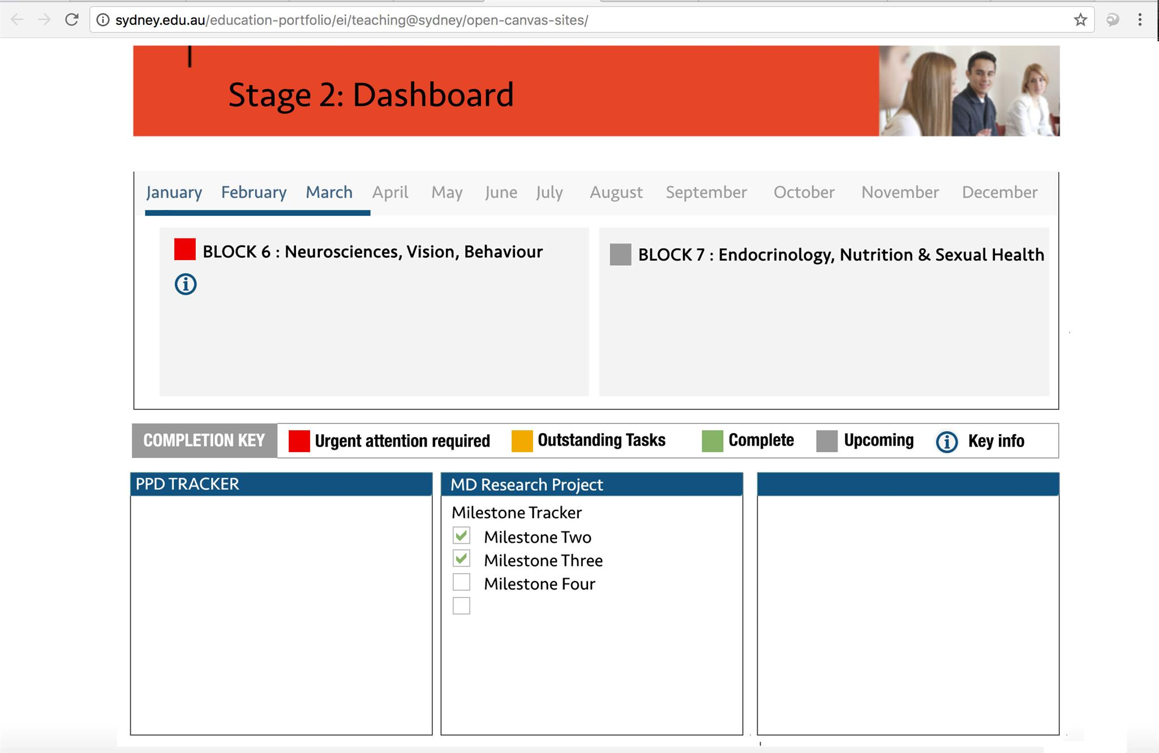

Slide 8
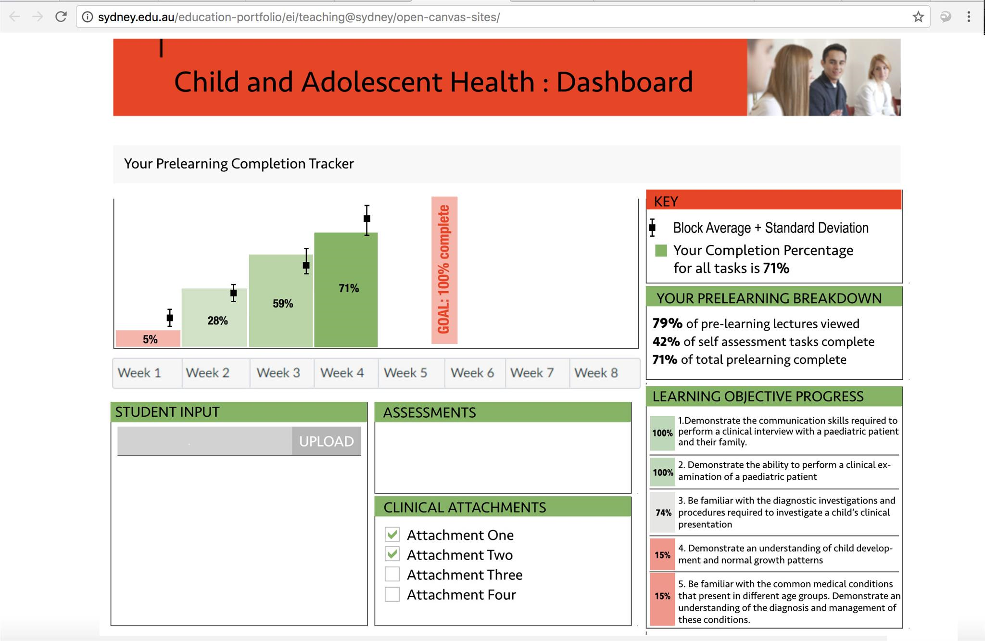

Slide 9
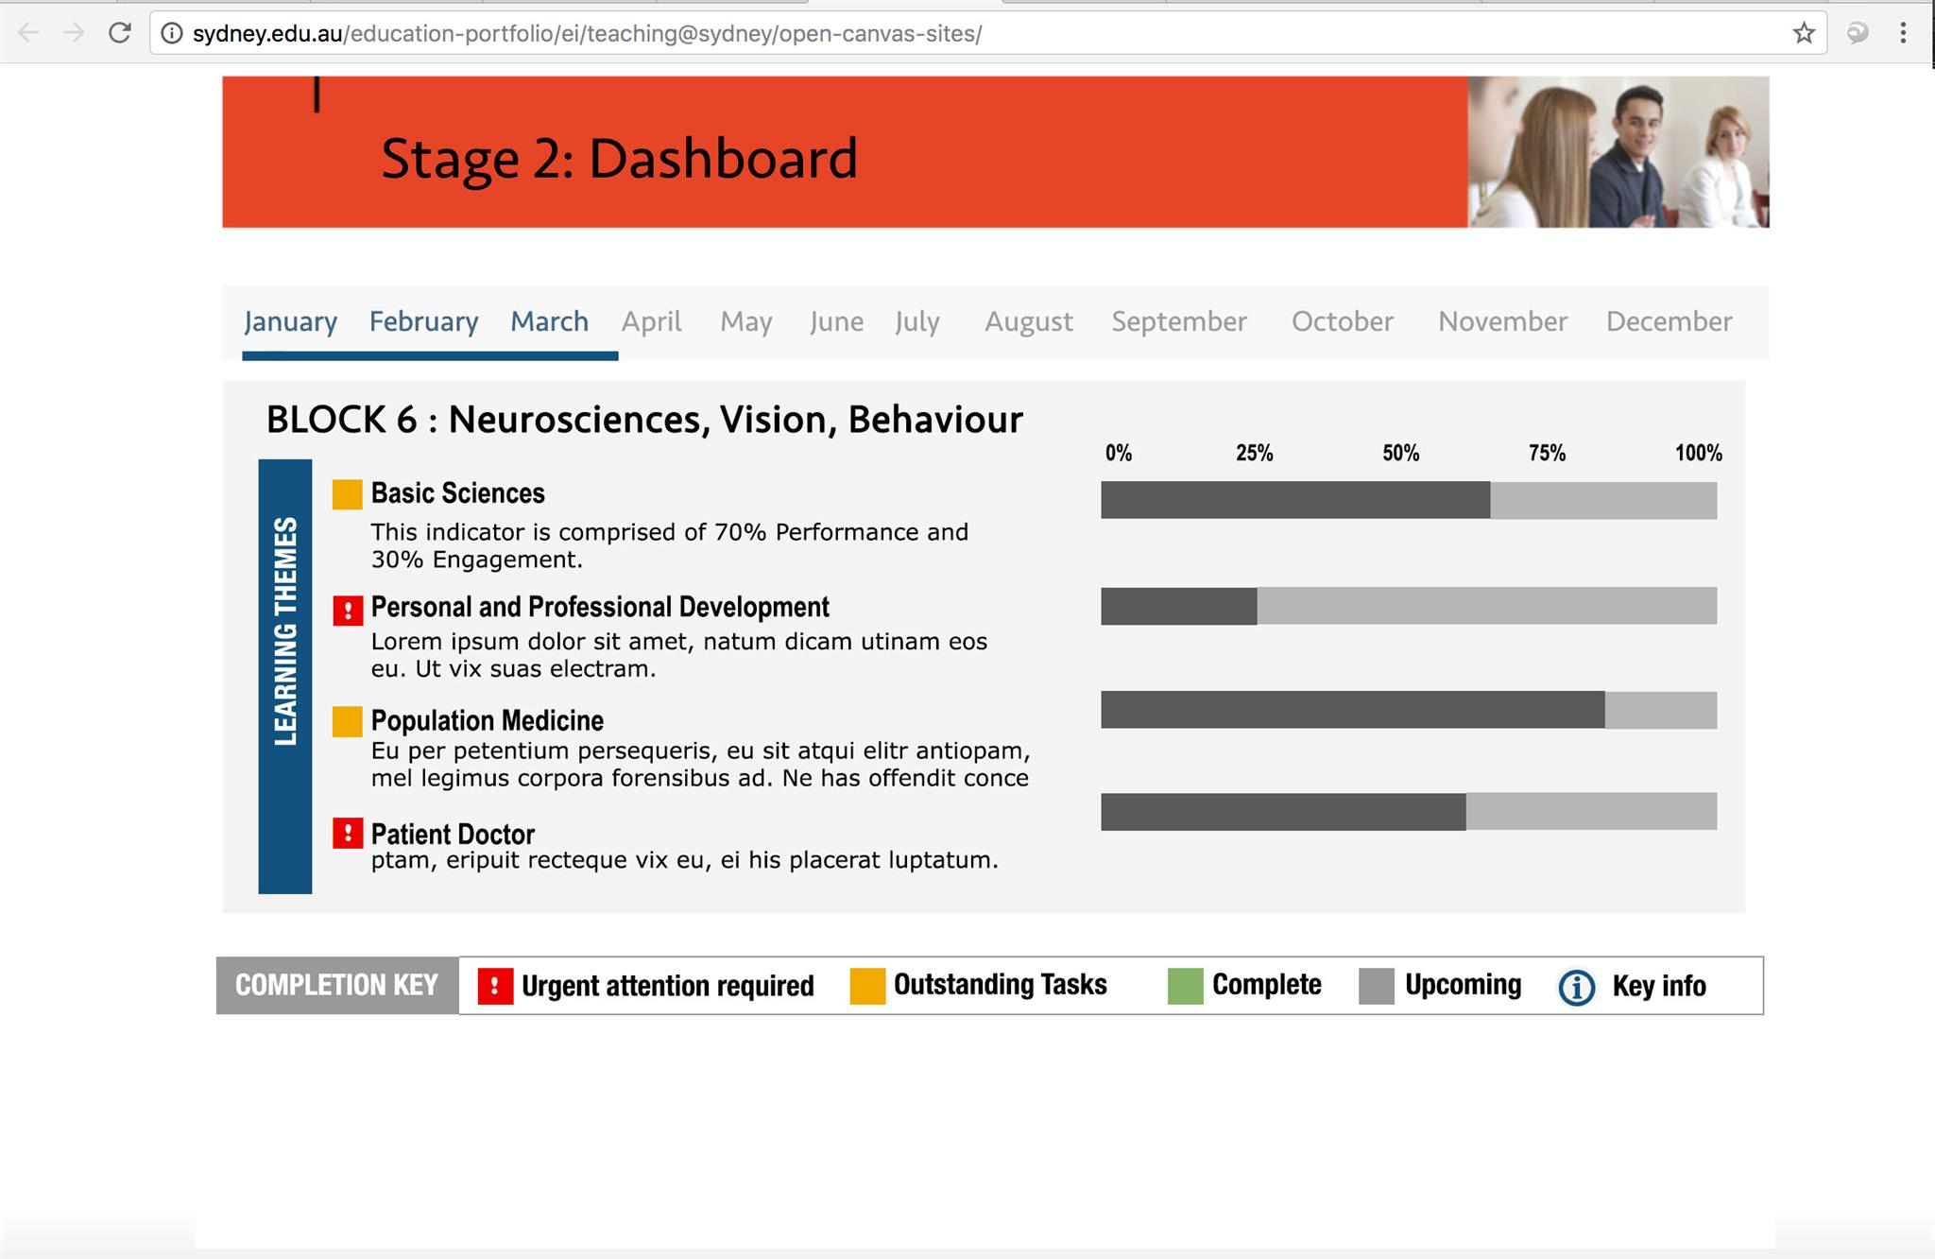

Slide 10
Next steps
Next hackathon:
24-25 October 2018, Amsterdam NL

